Slide 1

Invariance Testing
Lynette H. Bikos, PhD, ABPP

Slide 2
Does the test function similarly for different groups?
Gender
Cross-national samples
Different languages
Political party
It is not enough to simply conduct a CFA in that group, rather
We must formally assess for multi-group invariance (aka, invariance testing)

Slide 3
A confusing nomenclature
Variance: the opposite of constant, the variable changes from one person (or sample) to another.
Invariance: synonymous with equivalence. There are not statistically significant differences between the two versions/models being compared.
Noninvariance: synonymous with nonequivalence. There are statistically significant differences between the two versions/models being compared.
Equality constraints: imposed by the researcher when we specify (require) two more parameters to be equal.

Slide 4

A scale can claim “measurement invariance”
When a set of indicators measures the same constructs with equal precision over different samples.
Of course this can be nuanced:
Longitudinal measurement invariance evaluates the stability in measurement parameters over time for the same population
Method invariance is concerned with whether different methods of administration (e.g., online v. paper/pencil) are invariant.
We can also test SEM models – asking questions like, “Does this moderated relationship hold across samples?”

Slide 5
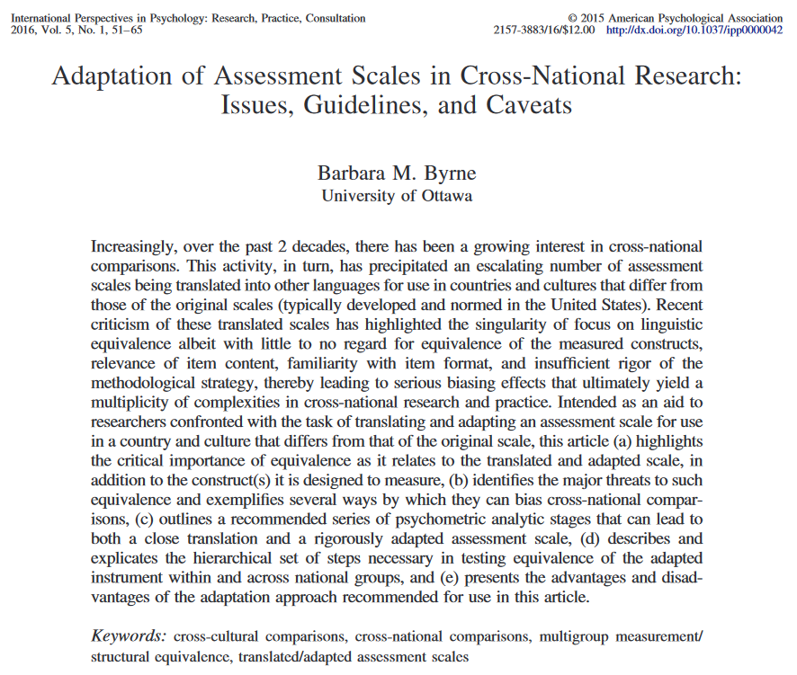
Old school is OUT
Previously we could claim that a test was culturally adaptive if it involved
Translation/backtranslation
Replication of factor structure within the culture
Replication of validity and reliability estimates

Slide 6
Two approaches: that usually end up with the same conclusion
Free baseline approach
Constrained baseline approach
Respecification from nesting to nested models.
Fit generally worsens in each subsequent model.
The goal is non-significant differences in fit with each additional set of cross-group equality constraints.
Respecification from nested to nesting.
Fit generally improves in each subsequent model.
The goal is to have satisfactory fit in the most restricted model.

Slide 7
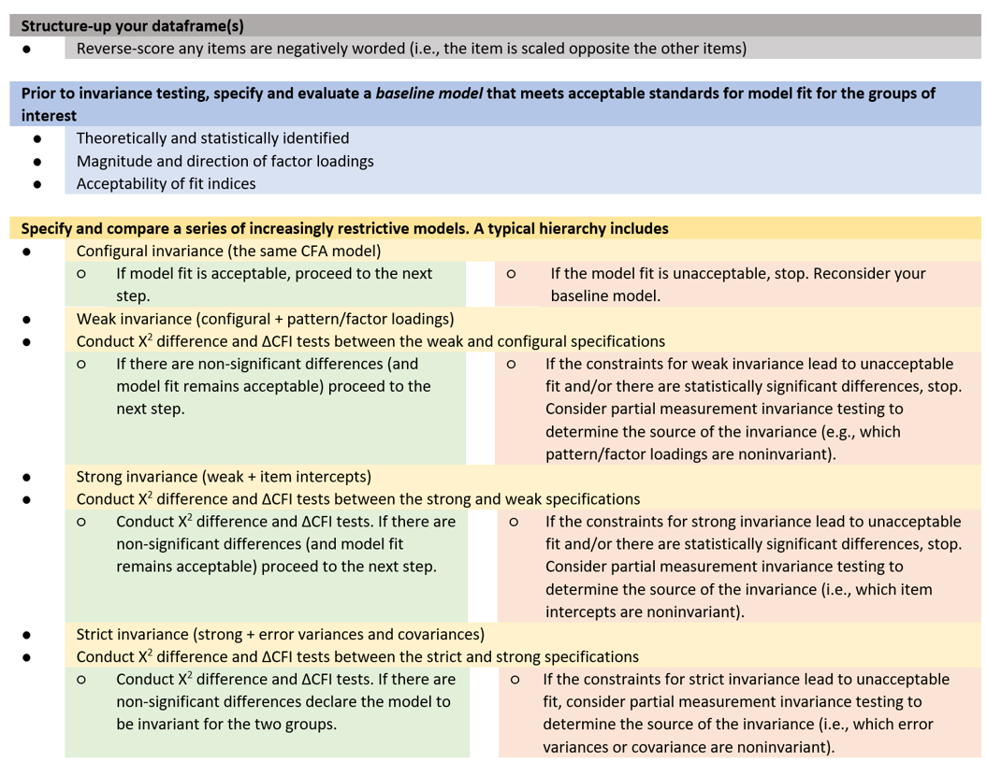





Slide 8
Tests for Model Comparison
Chi-square difference test
A non-significant chi-square difference test indicates that the stricter invariance hypothesis should not be rejected.
Restated: We want p > .05
Change (delta) CFI:
We simply subtract the CFI from the stricter model to the one that immediately preceded it. When the difference < 0.01, invariance is supported.

Slide 9
Partial measurement invariance
As we move from one level to the next, we will likely hit significant differences.
You can stop and investigate where the invariance occurs. An example is Byrne’s work with the Maslach Burnout Inventory between elementary and secondary teachers where invariance was stopped at factor loadings. They were able to determine which item (or items) were different among the groups.

Slide 10
How invariant is enough?
Byrne (2016) commented that the Joreskog tradition of requiring the equality of error variances and covariances (i.e., “strict”) was toooo strict.
Researchers are often satisfied if they make it to “weak” (equality of factor loadings) invariance.

